Slide 1
DBMS PROJECT
ON TOPIC
ONLINE EXAMINATION SYSTEM
SHIVANI MEHRA
RA2111003011911
N2

Slide 2
AIM AND OBJECTIVE
* Online Examination System is web-based application for technical evaluation.
* It not only replaces paperwork but also releases the workload of the faculty.
*It fulfills the requirements of the institute to conduct the exams online.
*The required software and hardware are easily available and easy to work with.
* Online Examination System, as described above, can lead to error free, secure,
reliable and fast management,
* Thus, it will help organization in better utilization of resources. The organization can
maintain computerized records without redundant entries.
* That means that one need not be distracted by information that is not relevant, while
being able to reach the information.

Slide 3
PROBLEM STATEMENT
*Online Examination System can lead to error free, secure, reliable and fast management system. It can assist the user to concentrate on their other activities rather to concentrate on the record keeping. Thus, it will help organization in better utilization of resources.
*With the development of information technology and use it in an orderly and properly
helps to overcome the existing error in the manual system.
*Online examination system saves the exams information in a database
*This make it an easier way to give exam teachers can add their exams rules, and
student can give exam in a totally automated system.

Slide 4
EXISTING APPROACH
The Existing system of conducting examination process is manual. Existing system is a
large man power process and is difficult to implement it at different platform. It has so
many problems. So, we introduce an Online Examination system, which is fully
computerized. Existing system is a large man power process and is difficult to
implement.
The following drawbacks of existing system emphasize the need for computerization:
• a lot of copies of question papers have to be made
• a lot of correction work hence delays in giving the results
• a lot of tabulation works for each subject results

Slide 5
Limitation of existing system
Since the traditional have many drawbacks such as:
a) Time consuming
b) Difficulty of analyzing the test manually
c) More observers are required to take exam of many students
d) Results are not accurate since calculations is done manually
e) The chance of losing exam's result is higher in current systems
f) Checking of result is time consuming since it done manually
g) Limited no of students can give examination at a time.

Slide 6
**It may help collecting perfect management in details. In a very short time, the collection will be obvious, simple and sensible. **It will help person to know the management of passed year perfectly and vividly. **It also helps in current all works relative to Online Examination System. ** It will also reduce the cost of collecting the management & collection procedure will go on smoothly.
PR0P0SED SYSTEM

Slide 7
HOW OUR SOLUTION DIFFERS
*Low internet connection would be sufficient to load the pages, since we haven’t used any
picture data (using pictures the user with low internet connection takes time to load the
images). In other online exam system websites, we can find only one admin who is surely
responsible for the addition or deletion of the test, but we made this site any number of
authorized persons can add/remove the examinations and these all authorized persons and users of this site will be controlled by the admin. It could be very helpful for educational institutes acting as:
***Admin --- director of institute
*** Teacher --- professors of college
*** User --- students of the college
*** home page Security with password, even the admin cannot look at the password ,
ensuring the trust of the users. A feedback system available for suggesting
improvements and registering complaints.

Slide 8
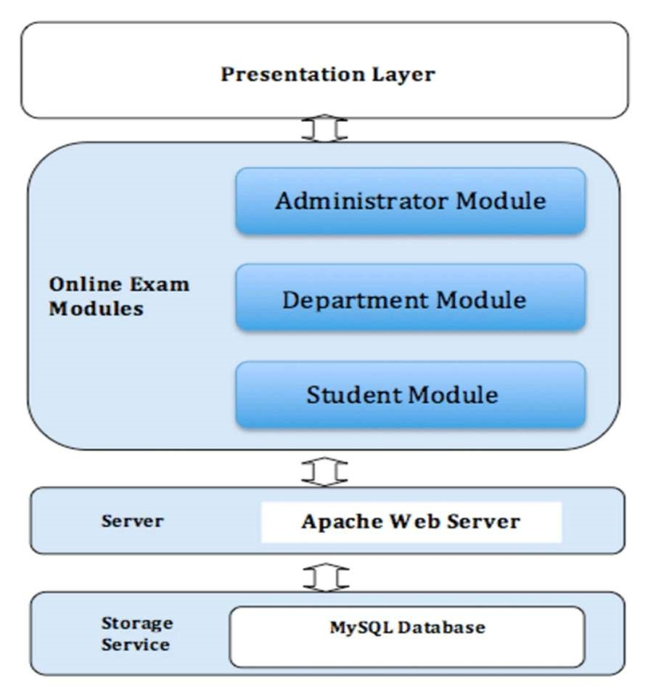
ARCHITECTURE DIAGRAM

Slide 9
SOFTWARE rEQUIREMENT
Front end: HTML, CSS, JavaScript
• HTML: HTML is used to create and save web document. E.g. Notepad/Notepad++
• CSS: (Cascading Style Sheets) Create attractive Layout
• JavaScript; it is a programming language, commonly use with web browsers.
Back end: PHP, MySQL
• PHP: Hypertext Pre-processor (PHP) is a technology that allows software developers
to create dynamically generated web pages, in HTML, XML, or other document
types, as per client request. PHP is open source software.
• MySQL: MySQL is a database, widely used for accessing querying, updating, and
managing data in databases

Slide 10
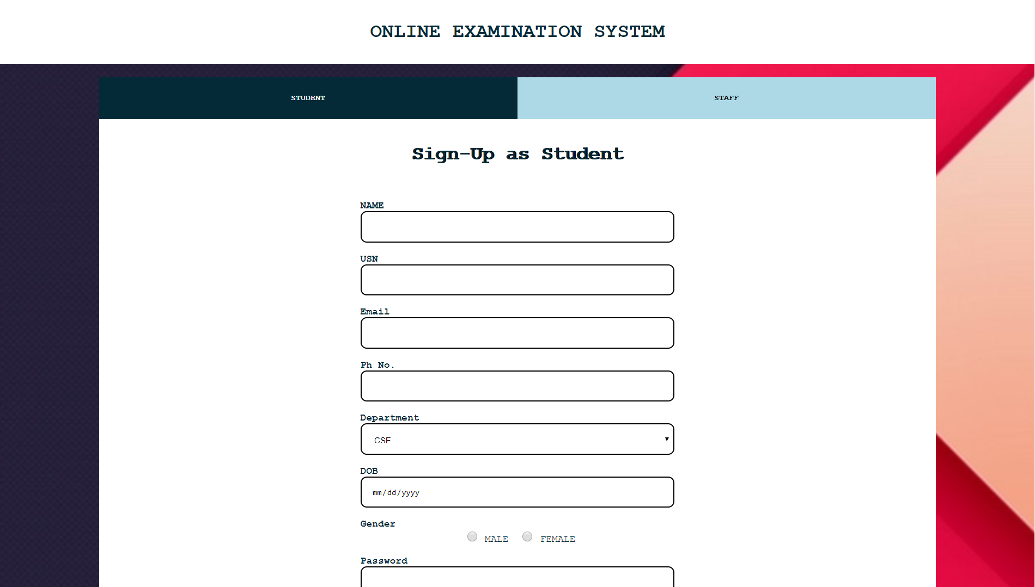
RESULT

Slide 11
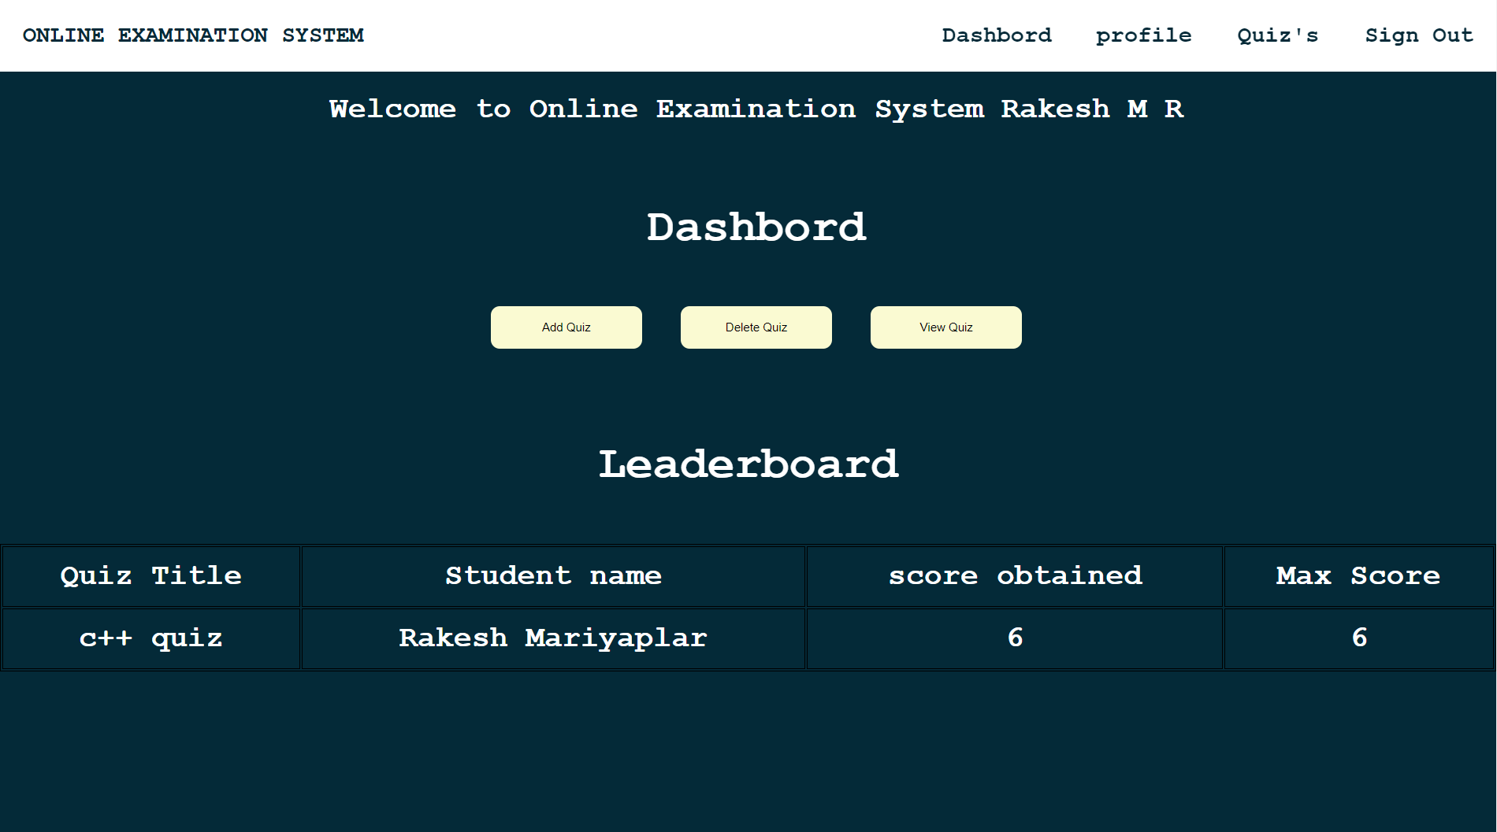

Slide 12
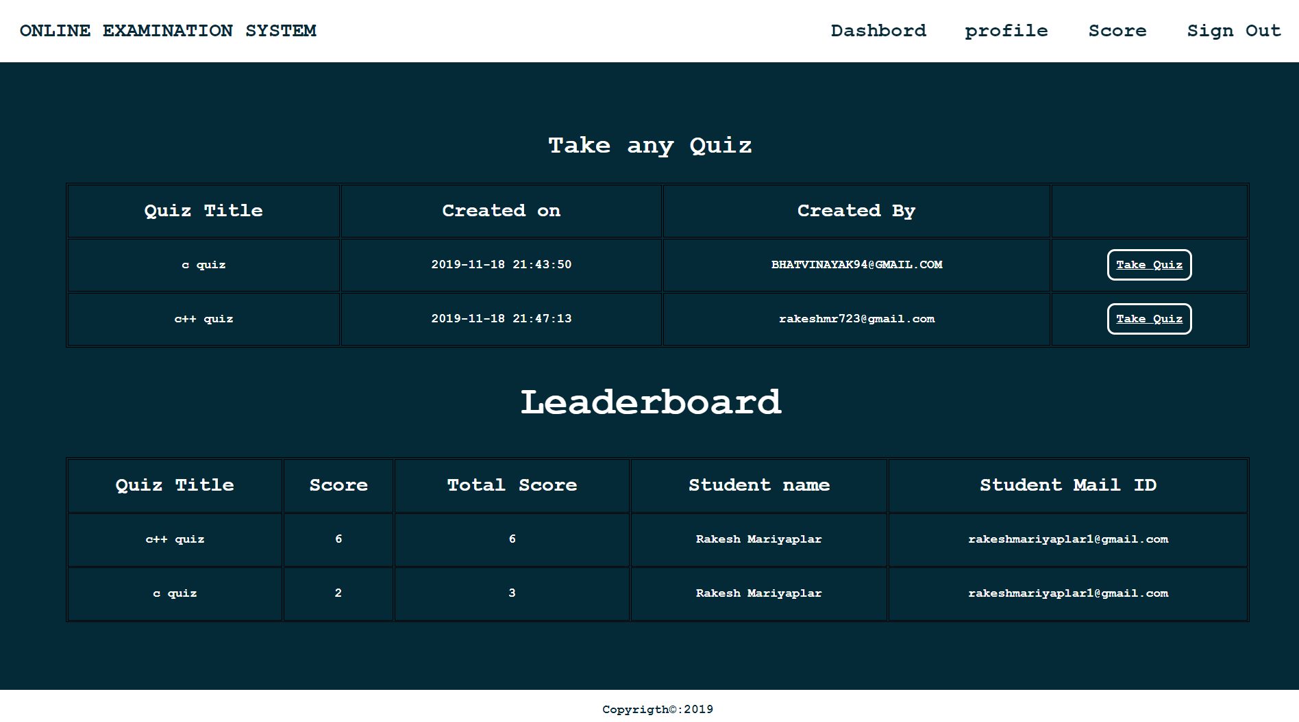

Slide 13
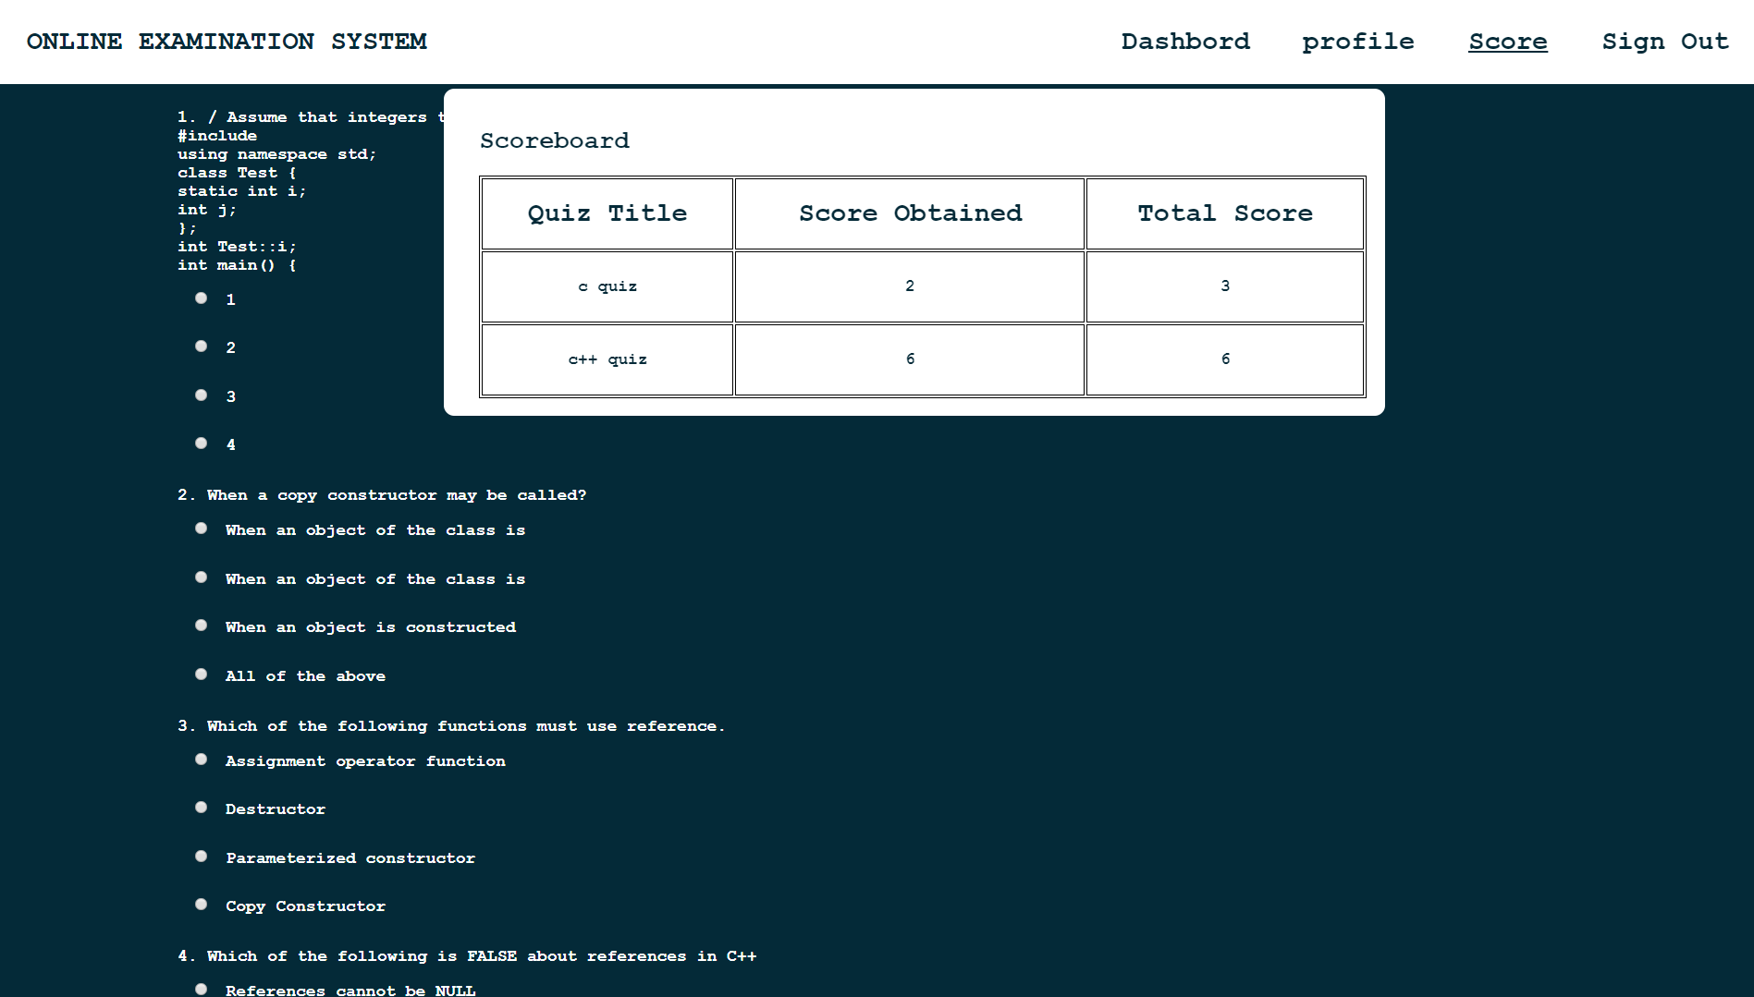

Slide 14
REFERENCES
**https://www.eklavvya.com/blog/
** https://ieeexplore.ieee.org/
** https://www.researchgate.net/

